Slide 1
Login Page
Without reference tag

Slide 2
Languages used in Login Page
HTML
CSS
JavaScript

Slide 3
HTML
Tag usages
Div tag
Form tag
H1 tag
Anchor tag
Img tag
Italics tag
Span tag
Input tag
Button tag
Script tag
Attribute usages
Class
Action
Src
Type
Placeholder
Id

Slide 4


JavaScript
SignUp – Click
For going to signing up page
For signing up
SignIn – Click
For Signing in the page
For Signing In

Slide 5
Process of this project
Process of this project
Got the requirements from the program
Assigning different works to the team
Team processes the whole project and give the final output
Requirements
Assigning
Process

Slide 6
Login Page End Product

Slide 7
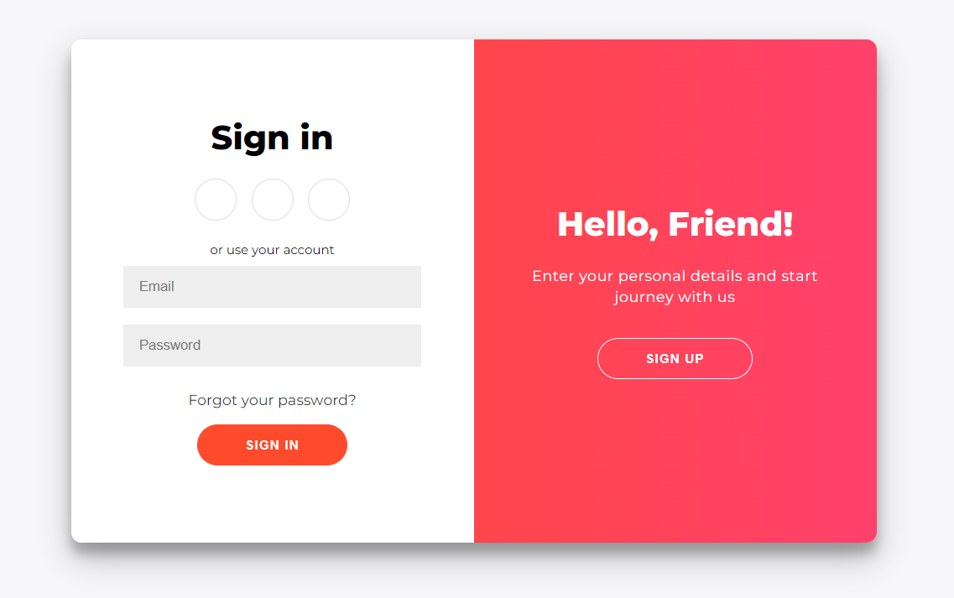

Slide 8
